Slide 1
Build foundation models using Azure Container for PyTorch and Azure ML
Parinita Rahi
Savita Mittal
Baiju Meswani
Prathik Rao
May 2023

Slide 2
AI Landscape
Organizations need ability to scale out
Explosion of data
Advanced large language models
175-180 zettabytes of worldwide data volume is predicted by 2025.¹
1
175B parameters in GPT-3. and was trained on 570 gigabytes of text. GPT4 on even more…
a
3
e
c
o
e
p
f
h
2
r
s
v
g
k
t
u
Fairness, Inclusion & Accountability
Time commitment
l
j
w
4
x
64% of organizations take a month or longer to deploy a machine learning model.²
n
m
aa
y
1)AI is built and used responsibly and ethically, 2) advances international competitiveness and national security and 3) serves society broadly, not narrowly
bb
cc
dd
1 What are network edge data centers? | Schneider Electric Blog, December 2022
2 Model Deployment Challenges: 6 Lessons from 6 ML Engineers | neptune.ai, January 2023
3 How Large Language Models Will Transform Science, Society, and AI | Stanford University HAI, February 2021
4GPT-4 (openai.com)
Notes:
AI Landscape (pause) Interesting huh? So much game changing things happening around us
We are at a turning point moment in the AI journey, where AI in generative and other forms offers unusually large set of capabilities, including text summarization, chatbots, search, and code generation. And we are just getting started on this journey. This landscape is now synonymous with massive amount of data and complex models. Managing complex data is not an easy task, especially under the time constraints imposed by discovery deadlines. Training time depends on the complexity of the model selection. GPT-2 was over 100 times smaller than GPT-3, GPT-3 has 175 billion parameters and was trained on 570 gigabytes of text. GPT4 is an even more complex models trained on a larger dataset.The right technology can make model development processes faster, easier, and less costly for your organization. Efficiency and Agility aside, organization are also faced with the challenge to do this right. As a developer and deployer of Game changing AI technology, Microsoft is committed to working with others to ensure AI is: 1) is built and used responsibly and ethically, and serves society broadly, not narrowly. The Microsoft cloud is unique in both the breadth and the depth of the cloud solutions we provide. You can use each of our cloud solutions on a standalone basis or take advantage of the seamless way we’ve integrated and architected them to work well together. And with the Microsoft Cloud, we can enable you to use AI to drive transformation within your organizations. We are doing this in two ways: First, we’ll help you radically accelerate employee productivity and capability by leveraging transformational AI built into every Microsoft Cloud solution. As seen in ChatGPT, Bing integration, Github Copilot and Azure Open AI services to name a few..
.

Slide 3
Azure has the most comprehensive stack for Deep Learning
Category
Challenges
Audiences
What Azure Offers
Model Development
“ How do I train State of the Art models applicable to my organization?”
Prebuilt environments
Scaling model platform
“I need access to large amounts of compute and storage”
GPU reserved instance pre-bought
Model Training
“ How to innovate fast? ”
Training Optimization
Model Inference
“ I need a model small enough to be deployed on an edge device”
ONNX Runtime
Platform management
“How do we secure our models and data in the different phases of the lifecycle”
Pane of glass (AzureML)
Responsible AI
“I need to integrate an audit trail for a regulator”
Responsible AI
Knowledge & experience
“Our employees should be able to focus on their core skill without having to learn additional skills”
Built in functionality
Notes:
But not only that we are also committed to delivering the tools and services you need to build your own intelligent apps and services using Azure AI.
In this talk we will focus on how can organization, data scientists, ML experts can use Azure to build their model developments stack.
If you are curious about 1) How do I train State of Art models applicable to my organization – and make it easy for your teams and scientists to scale – we will talk about pre-build environments built esp. for Pytorch 2) We will cover how you can deploy your large models in production and easily create online endpoints in Azure ML 3) Given compute costs is the new currency how to best optimize inferencing with ONNX 4) How evaluate and build your models to abide by the responsible AI principles.
Azure Machine Learning facilitates uptake of this AI-first infrastructure – from the earliest stages of development through to enterprise-grade production deployments that require full-blown MLOps. We are continuing to build our RAI program by investing in research, policy, and engineering so that our systems can perform fairly, accurately and safely. Core to this is advancing transparency and ensuring humans remain accountable for the performance of AI systems.

Slide 4
How PyTorch works on Azure?
Deploy Inference Monitor | ONNX Format | ONNX Converter | ONNX Runtime Inference
Benefits
Easier Setup with ACPT
Cheaper, faster training and inference with ONNX Runtime
Code once, deploy on GPU and mobile with ONNX format models
Works with your code
Native integration with AzureML
Models | Public: Transformers, CNN, LSTM, RNN, … | Microsoft: GPT-3, Bing Ads, …
User Code | Base Image | Scripts | Compute Targets | Jobs | Endpoint Deployment
ONNX Runtime | DeepSpeed | MSCCL | ORT MoE | More..
Comprehensive Training Frameworks | PyTorch | Python | Ubuntu | Cuda
Retrain
Microsoft Users
Bing / Bing Ads
Microsoft Office / Smart Reply
Cognitive Services / Speech
And more…
Azure Container for PyTorch (Curated Environment)
Training Methods | AzureML SDK | AzureML CLI | AzureML Studio
Hardware | NVIDIA GPUs (V100 32GB, A100 80GB) and more…
Use the same frameworks and infrastructure our internal teams use to train and deploy state-of-the-art PyTorch models at planet scale
*ONNX Runtime supports inference on TensorFlow as well
Notes:
Our internal teams leverage the Azure ML stack to churn cloud-based solutions effectively, and we offer the same goodness to our customers to benefit from.
Best hardware stack with state of art Nvidia GPUs, ease of training via sdk, cli, and UI – prebuilt images that combine the best of open source technologies that enable optimized and fast training cycles. – on which you can layer your custom code to build powerful models. Optimize, Deploy Inference and Monitor these models on any platform of your choice .
One of the tools that helps enable this journey is ACPT.

Slide 5


Azure Container for PyTorch (ACPT)
Optimized training framework
Up-to-date stack
Ease of use
Latest training optimization technologies
Native integration with Azure
Set up, develop, and accelerate PyTorch models on large workloads
Latest compatible versions of Ubuntu, Python, PyTorch, Cuda\ROCm, etc.
Installed and validated against dozens of Microsoft workloads to reduce setup costs and accelerate time to value.
ONNX Runtime, ORT MoE, DeepSpeed, Nebula, MSCCL, and others.
Monitoring, Deployments,
Customer support
Notes:
You can use the Azure Container for PyTorch (ACPT) curated environment for your large training workloads to help reduce preparation costs, faster deployment times, and accelerated training times. The software stack is up-to-date with the newest available and compatible versions of training software for ease of use.We release these images pretty much on a monthly cadence so you have the latest pytorch, python, cuda packages/binaries all in one place for quick training set up.These models have been validated and are in use by a large set of Microsoft internal teams. The optimization libraries like ONNX RunTime and DeepSpeed composed within the container can increase production speed up from 54% to 163% over regular PyTorch workloads as seen on various HuggingFace Models. ACPT reduces compute costs by performing the same training jobs in significantly less time. Training runs are also easily trackable as the curated environment is integrated with AzureML tools such as the Azure Machine Learning Studio and the Azure.
DeepSpeed (https://www.deepspeed.ai/)
DeepSpeed offers a confluence of system innovations – made large scale DL training effective, and efficient.
DeepSpeed brings together innovations in parallelism technology – a system technologies for inference.
DeepSpeed offers easy-to-use and flexible-to-compose compression techniques for researchers and practitioners – delivering faster speed, smaller model size, and significantly reduced compression cost.
ONNX Runtime (https://onnxruntime.ai/)
Built-in optimizations that deliver up to 17X faster inferencing and up to 1.4X faster training
Support for a variety of frameworks, operating systems and hardware platforms
Nebula (https://learn.microsoft.com/en-us/azure/machine-learning/reference-checkpoint-performance-for-large-models?tabs=PYTORCH&view=azureml-api-2)
A fast, simple, disk-less, model-aware checkpoint tool – offers simple, high-speed checkpointing
Helps reduce checkpoint save times and GPU hour demands for large model training jobs

Slide 6

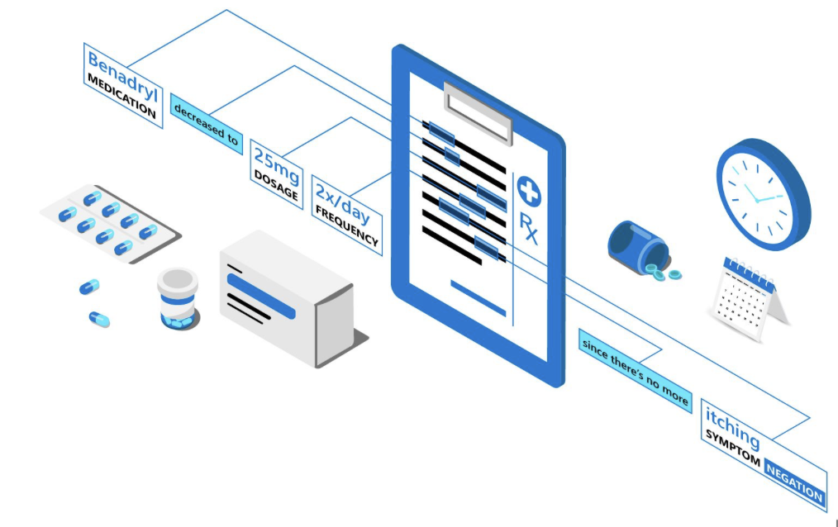
Customer: Microsoft Text Analytics for Health
Industry: Healthcare IT
Size: 10,000+ employees
Country: Israel, Belgium, USA
Products and services: Azure Container for PyTorch Azure Machine Learning
“With Azure Machine Learning and Azure Container for Pytorch we are cutting training time significantly while reducing costs by leveraging low priority compute”
—Tal Baumel Ph.D SENIOR DATA & APPLIED SCIENTIST • Health AI
In Text Analytics for Health, we train a Large Language Model to annotate clinical text and provide insights. Training times for such models take significant time on costly compute and any improvement is crucial
We migrated our training to Azure Machine Learning and used the latest Azure Container for PyTorch (ACPT) Images.
With the new ACPT in Azure Machine Learning we managed to reduce training time by sixth and unlocked InfiniBand and low priority compute capabilities that enable fast multi-node training for a fraction of our previous training costs.

Slide 7


Fashable Customer Case Study
Customer:
Fashable
Industry:
Retail
Size:
Small (1-49 employees)
Country:
Portugal
Products and services:
Azure Machine Learning Azure Container for PyTorch
Read full story here
Fashable reimagines the future of fashion design with Azure Machine Learning and PyTorch
“Azure Container for PyTorch (ACPT) environment helps us in running our model with Distributed Data-Parallel (DDP) implementation. We were able to successfully run the model with multi nodes and get the results effectively and efficiently. When using an environment other than ACPT, we were not able to achieve that”
- Orlando Ribas Fernandes, Co-Founder and CEO, Fashable
Notes:
Fashable created an AI algorithm that can generate original clothing designs, helping fashion companies to meet customer demand, get to market faster, and reduce clothing waste.
A small startup that doesn’t have the capability to make huge upfront investments on those machines, so it was super important to find something that could support GPU usage in a cost-effective way. Azure helps us train our models without making those types of investments and helps our research team work faster.

Slide 8
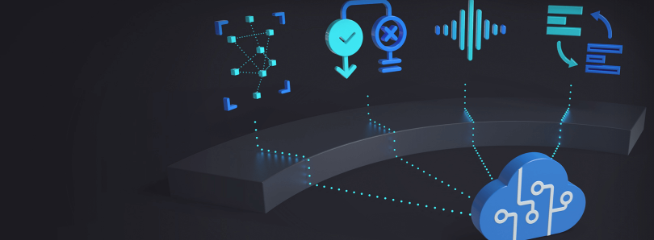

Azure Cognitive Services CASE STUDY
Customer:
Microsoft – Azure Cognitive Services
Industry:
Partner Professional Services
Size:
Corporate (10,000+ employees)
Country:
United States
Products and services:
Azure Machine Learning Azure Container for PyTorch
Azure Cognitive Services accelerates its core research work with Azure Container for PyTorch
“ACPT images help us successfully run large scale jobs on over 100 GPUs. It provides integration of different acceleration packages, such as OFED and APEX. More importantly, it removes our engineering efforts on building the images. It enables us to focus more on the research work.”
- Project Florence, a Microsoft AI Cognitive Services initiative
Notes:
Project Florence is a Microsoft AI Cognitive Services initiative, to advance the state-of-the-art computer vision technologies and develop the next generation framework for visual recognition that was able to use ACPT to run scale jobs over 100s of GPUs and helped the teams worry less about set and focus more on their research work.

Slide 9
PyTorch 2.0 with ACPT
Eager Mode + Dynamic Shape Support (TorchDynamo, AOTAutograd, PrimTorch and TorchInductor)
Machine Learning Scientist
Compiler/Hardware Engineer
Large-scale DL projects
Code contributor
30%+ training speedups, lower memory usage with no changes to code or workflow
Dramatically easier to write a PyTorch backend
State of the art distributed capabilities
Substantially more PyTorch is written in Python
acpt-pytorch-2.0-cuda11.7: 6 - Microsoft Azure Machine Learning Studio
Notes:
ACPT now also provided ease of experimentation with PyTorch 2.0. PyTorch 2.0 is accelerated, it's fast and it runs large training jobs efficiently.
Torch.compile is the main API for PyTorch 2.0, which wraps your model and returns a compiled model. It is a fully additive (and optional) feature and hence 2.0 is 100% backward compatible.​
TorchInductor with Nvidia and AMD GPUs utilizes OpenAI Triton deep learning compiler to generate performant code and hides low level hardware details. ​
Accelerated Transformers introduce high-performance support for training and inference using a custom kernel architecture for scaled dot product attention (SPDA).​

Slide 10
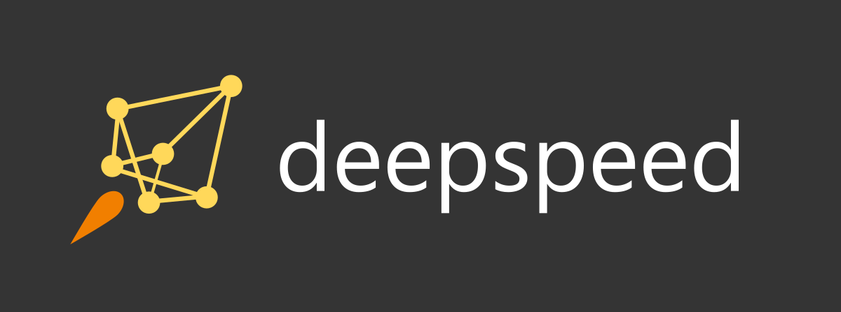
Deepspeed with ACPT
Open-source DL optimization software for DL Training and Inference
https://www.deepspeed.ai
Train/ Inference dense or sparse models with billions or trillions of parameters
Achieve excellent system throughput and efficiently scale to thousands of GPUs
Train/ Inference on resource constrained GPU systems
Scale
1 trillion parameters
Speed
Up to 10x faster
Achieve unpreceded low latency and high throughput for inference
Usability
Few lines of code changes
Cost
Over 6x cheaper
Achieve extreme compression for an unparalled inference latency and model size reduction
Notes:
Deep speed is an open-source Deep learning optimization software that provides 10X faster training and is 6X cheaper to train and inference dense or sparse models with billions or trillions of parameters. You can easily use Deepspeed with your pytorch model using ACPT and few lines of code change in your training jobs.

Slide 11


ONNX Runtime with ACPT
https://onnxruntime.ai/
Use ONNX Runtime (ORT) with the platform of your choice
Easily wrap existing model.
ORT Training:
Converts model to ONNX format.
Builds forward and backward graphs
model = ORTModule(model)
ORT Inference:
import onnxruntime as ort
# Load the model and create InferenceSession
model_path = "path/to/your/onnx/model" session = ort.InferenceSession(model_path)
Flexible and extensible hardware support - Train in one framework and transfer to another for inference
Larger Models - Memory optimizations allow fitting a larger model such as GPT-2 on 16GB GPU, which runs out of memory with stock PyTorch
Composable with popular acceleration libraries – For example Deepspeed, Fairscale, Megatron for even faster and more efficient training
Built-in optimizations that deliver up to 17X faster inferencing and up to 1.4X faster training
With ORT inference you can easily port onnx graph for on device training (Coming soon!)
Notes:
ONNX Runtime is a cross-platform machine-learning model accelerator, with a flexible interface to integrate hardware-specific libraries. With ONNX Runtime or ORT you can train in one framework and easily transfer to another for inference. Using the ORTModule class wrapper, ONNX Runtime for PyTorch runs the forward and backward passes of the training script using an optimized automatically-exported ONNX computation graph. ORT Training uses the same graph optimizations as ORT Inferencing, allowing for model training acceleration. The ORTModule is instantiated from torch-ort backend in PyTorch. This new interface enables a seamless integration for ONNX Runtime training in a PyTorch training code with minimal changes to the existing code. ONNX Runtime Inference powers machine learning models in key Microsoft products and services across Office, Azure, Bing, as well as dozens of community projects. Load and run the model with ONNX Runtime. (Optional) Tune performance using various runtime configurations or hardware accelerators.
ONNX Runtime is open source and we’ve seen good growth in 3P usage Run on different hardware and operating systems Train in Python but deploy into a C#/C++/Java app
Our customers span a range of scenarios – companies like InFarm using it to power computer vision running on a tractor to Apache OpenNLP using it for running NLP models through Java in Apache Solr and Lucene. Hugging Face is of course a big user of ONNX Runtime and has integrated it deeply into their offerings.Hardware vendors are also adopting ONNX and writing backends for ONNX Runtime. While we partner closely with Intel, Nvidia, AMD, etc. we also seen companies like Groq and Huawei build plugins for their hardware and contribute to the ONNX community.

Slide 12
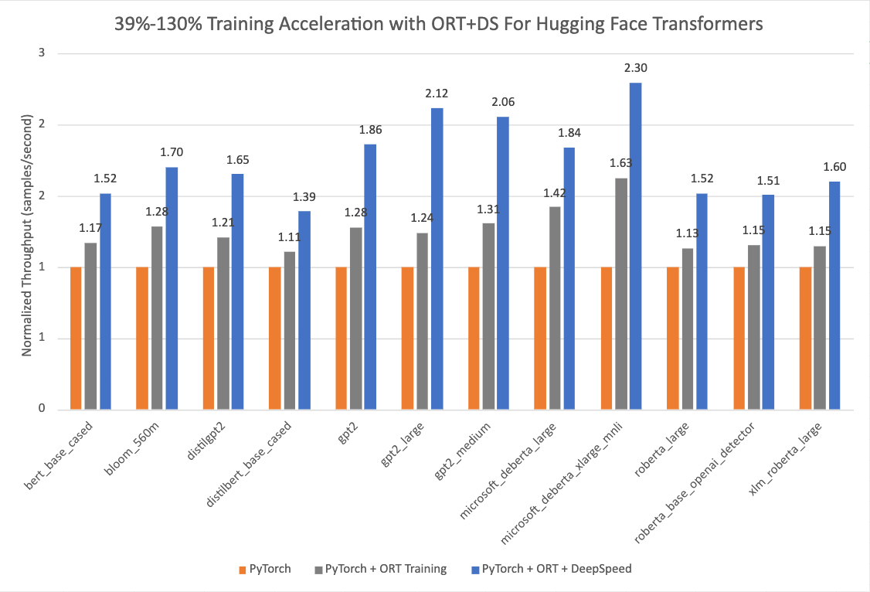
ONNX Runtime with ACPT
https://onnxruntime.ai/
PyTorch: 1.14.0.dev20221103+cu116; ORT: 1.14.0.dev20221103001+cu116; DeepSpeed: 0.6.6; HuggingFace: 4
.24.0.dev0; Optimum: 1.4.1.dev0; Cuda: 11.6.2
39% to 130% for Hugging Face models with Optimum when using ONNX Runtime and DeepSpeed ZeRO Stage 1 for training
Pytorch 2.0 , ORT 1.14.1 , deepspeed nightly 4/28
How to accelerate training with ONNX Runtime (huggingface.co)
Notes:
Updated versions of ORT is included in ACPT. Optimum integrates ONNX Runtime Training through an ORTTrainer API that extends Trainer in Transformers. With this extension, training time can be reduced by more than 35% for many popular Hugging Face models compared to PyTorch under eager mode. The chart on left shows impressive acceleration from 39% to 130% for Hugging Face models with Optimum when using ONNX Runtime and DeepSpeed ZeRO Stage 1 for training. The performance measurements were done on selected Hugging Face models with PyTorch as the baseline run, only ONNX Runtime for training as the second run, and ONNX Runtime + DeepSpeed ZeRO Stage 1 as the final run, showing maximum gains
The chart on right is our recent performance analysis with Pytorch2.0 for several HF models in both eager mode and torch.compile. We see torch.compile improve upon several models, however when torch compile is composed with Deepspeed the gain in throughput are even higher. Similarly DS+ORT provides gains for several model types. This an area that we continue to improve but the uber point is that with ACPT these technologies don’t just work in isolation but you can compose and see even more gains.

Slide 13
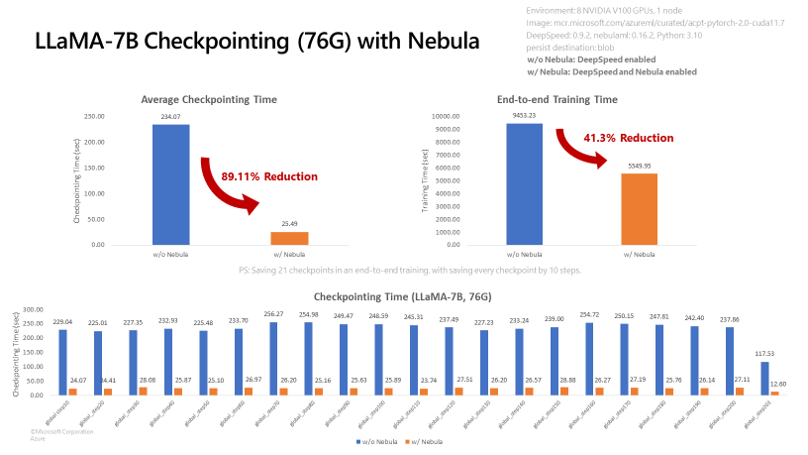
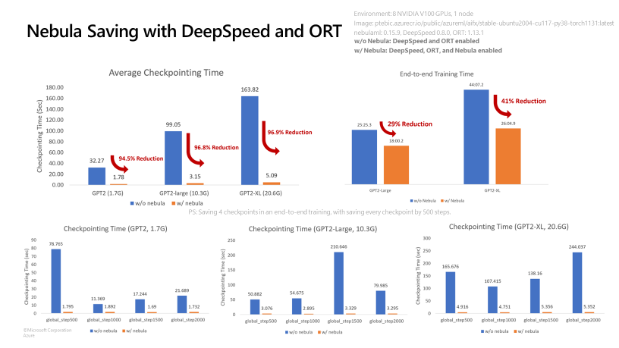
Nebula with ACPT
Boost checkpoint speeds by up to 1000 times
https://aka.ms/NebulaACPT
Boost Checkpoint Speed and Reduce Cost with Nebula (Preview)
High-speed checkpointing solution for distributed large-scale model training jobs using PyTorch
Nebula can reduce checkpoint times from hours to seconds - potentially saving 95% to 99.9% of time
Offers a simple way to monitor and view checkpoint lifecycles
Only available in the Azure Container for PyTorch (ACPT) curated environment on Azure Machine Learning

Slide 14
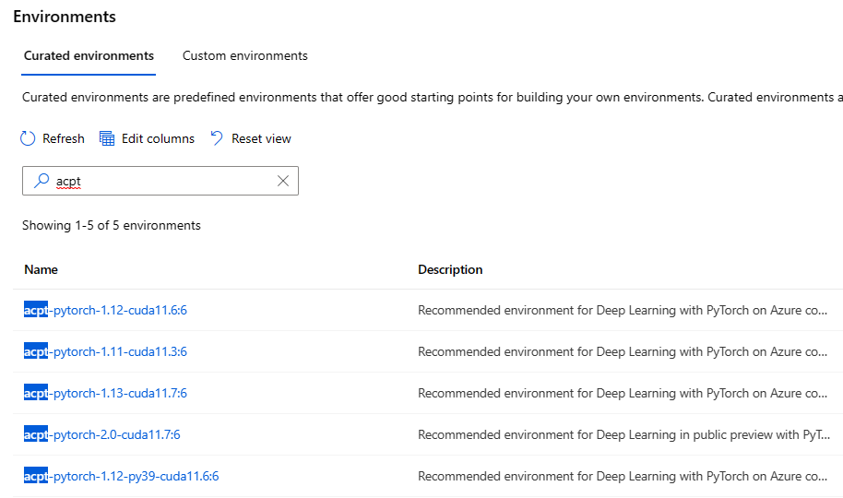
How to use ACPT?
Pre-built Curated Environments for Ease of use
https://ml.azure.com/

Slide 15
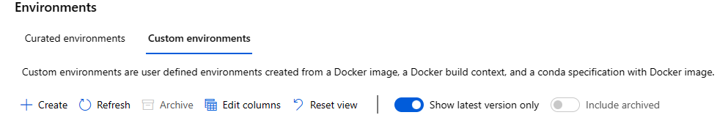
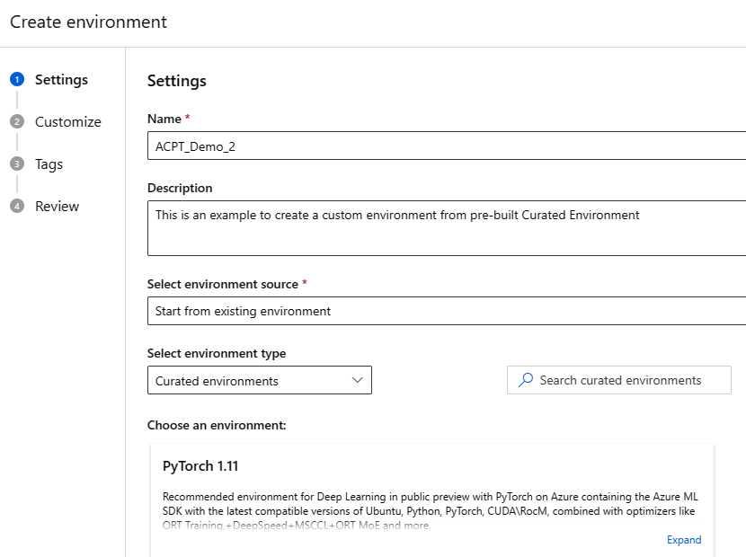
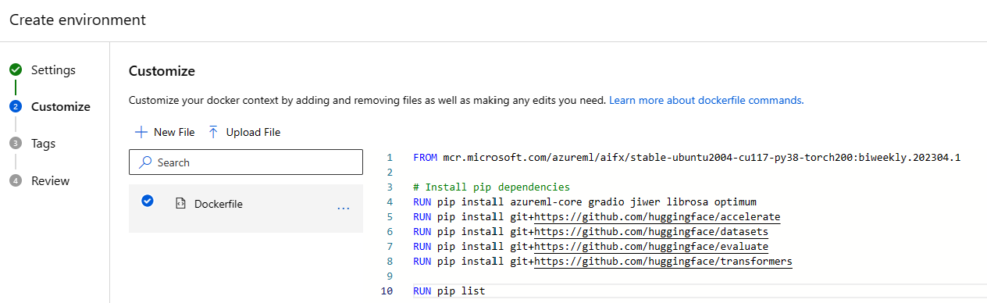
How to use ACPT?
Easily build Custom Environment using pre-built Curated environments

Slide 16
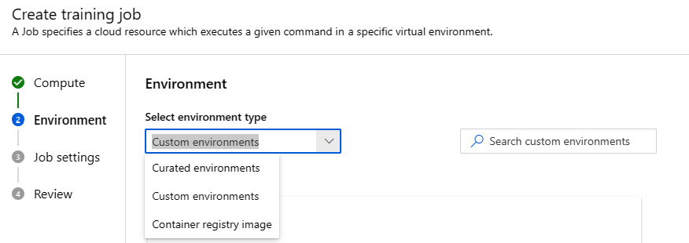
How to scale with ACPT?
Use pre-built Curated\Custom Environments across training jobs in your organization

Slide 17
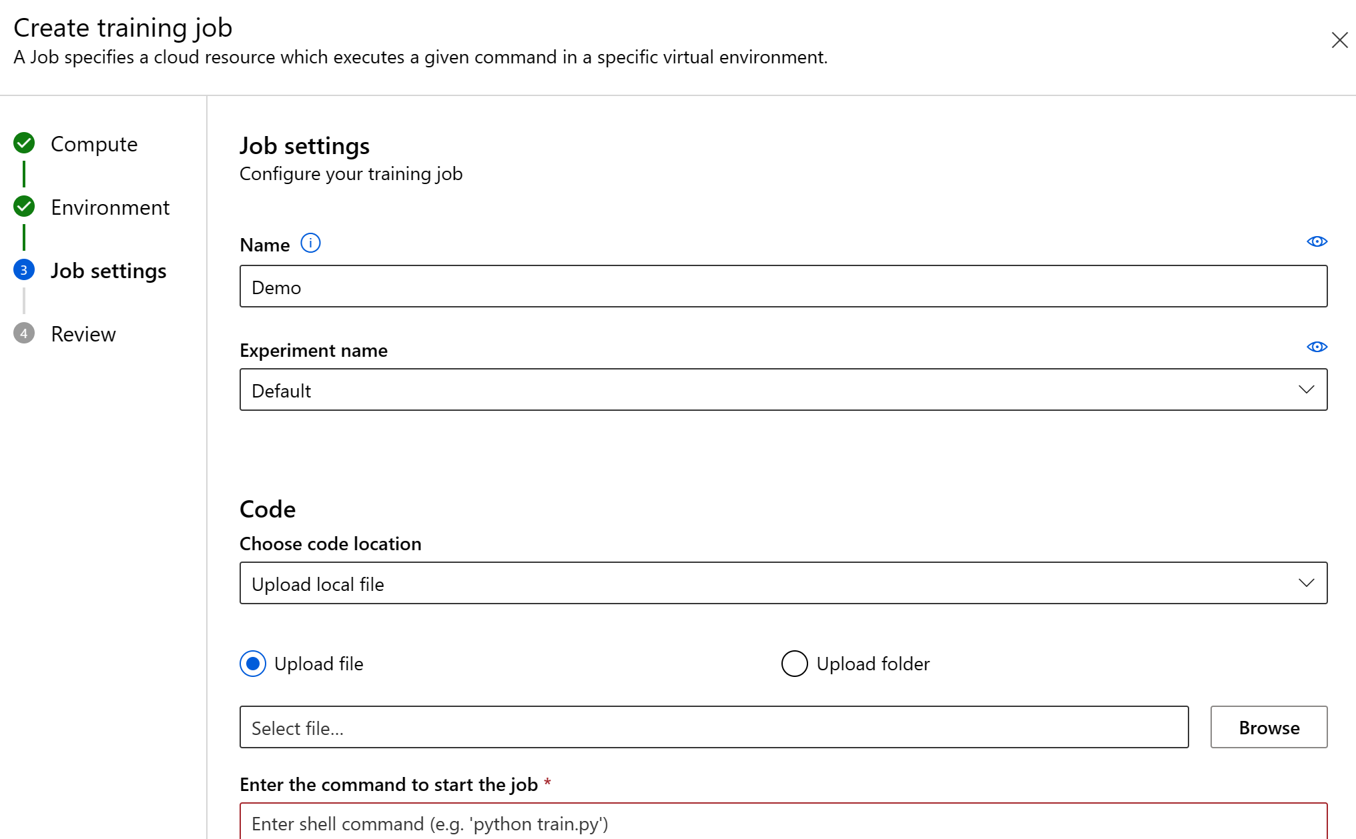
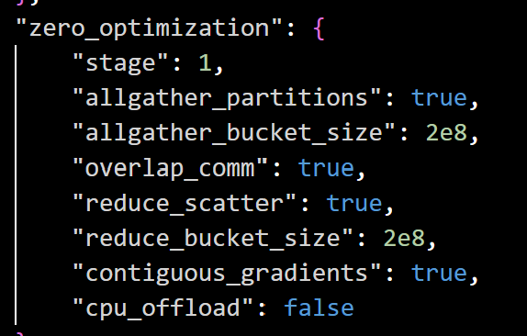
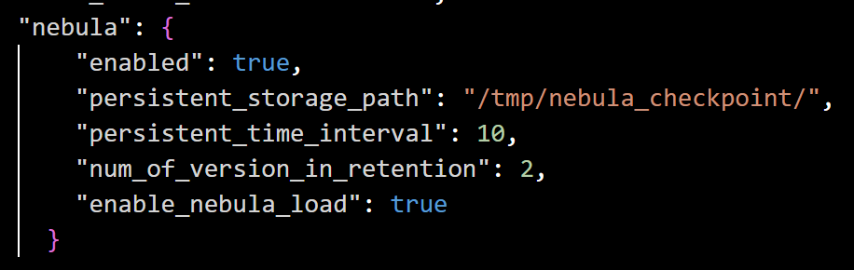
Optimize your training jobs using Microsoft’s Open-Source Technologies and Azure Machine Learning
https://github.com/microsoft/onnxruntime-training-examples/
Pyth aml_submit.py --ws_config [Path to workspace config json] --compute [Name of gpu cluster] [ORT + DeepSpeed flag]
--optim adamw_ort_fused
--deepspeed zero_stage_1.json
Optimum integrates ONNX Runtime Training through an ORTTrainer API that extends Trainer in Transformers.
Notes:
Optimum integrates ONNX Runtime Training through an ORTTrainer API that extends Trainer in Transformers. ORTTrainer and ORTSeq2SeqTrainer APIs make it easy to compose ONNX Runtime (ORT) with other features in Trainer. It contains feature-complete training loop and evaluation loop, and supports hyperparameter search, mixed-precision training and distributed training with multiple NVIDIA and AMD GPUs. ORT fused Adam optimizer: batches the elementwise updates applied to all the model’s parameters into one or a few kernel launches
With the ONNX Runtime backend, ORTTrainer and ORTSeq2SeqTrainer take advantage of:Computation graph optimizations: constant foldings, node eliminations, node fusions
Efficient memory planning Kernel optimization More efficient FP16 optimizer: eliminates a great de al of device to host memory copies
Mixed precision training’ In azure ML you can create training jobs select your environment and upload your training files and folders to easily use these technologies across your training jobs.

Slide 18
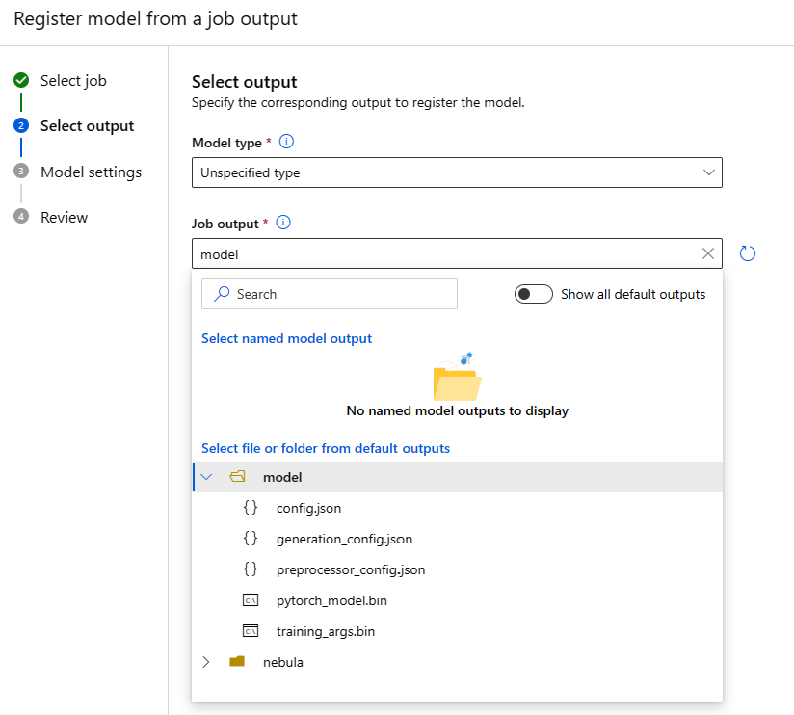
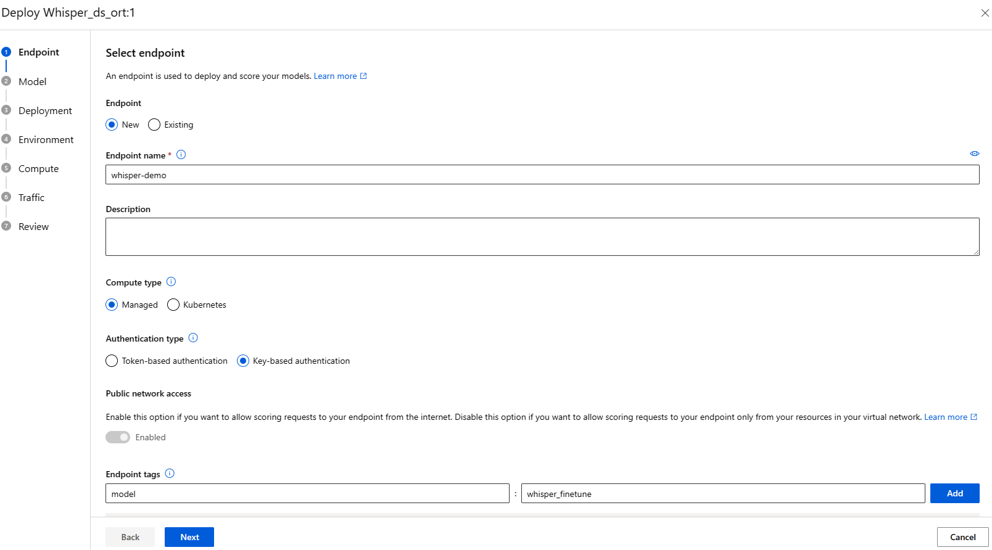
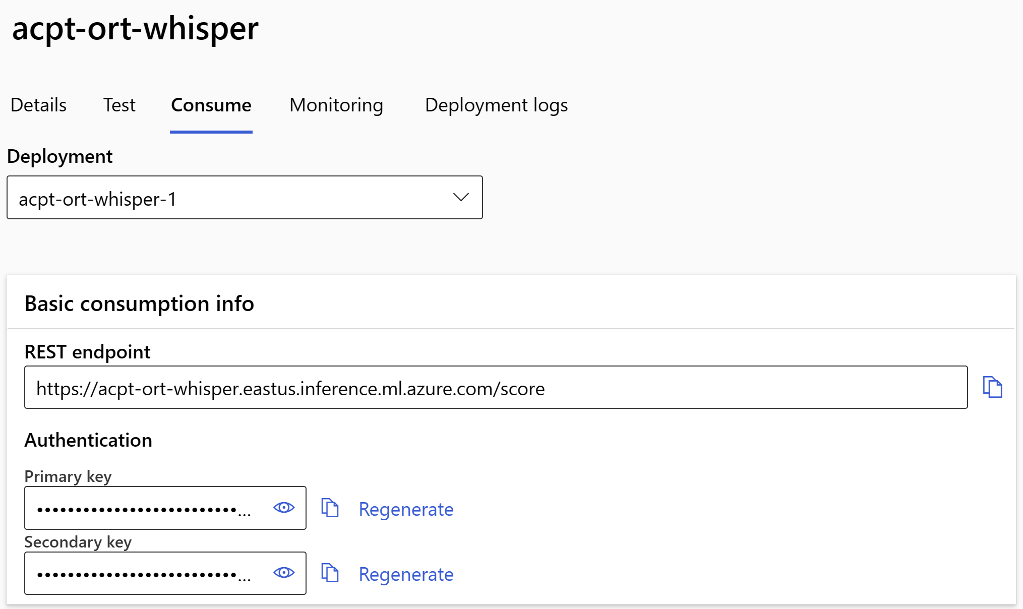
Use ACPT and ONNX Runtime to Speedup AzureML Online Endpoint Deployments
Register
Deploy
Create Online Endpoint
onnxruntime.transformers.models.whisper.convert_to_onnx
InferenceSession("whisper-small/openai/whisper-small_beamsearch.onnx, ..
Notes:
Write Managed online endpoints handles serving, scaling, securing & monitoring of your ML models, freeing you from the overhead of setting up and managing the underlying infrastructure. By converting the model to ONNX you make it easy to take it across platforms with simple few line changes

Slide 19
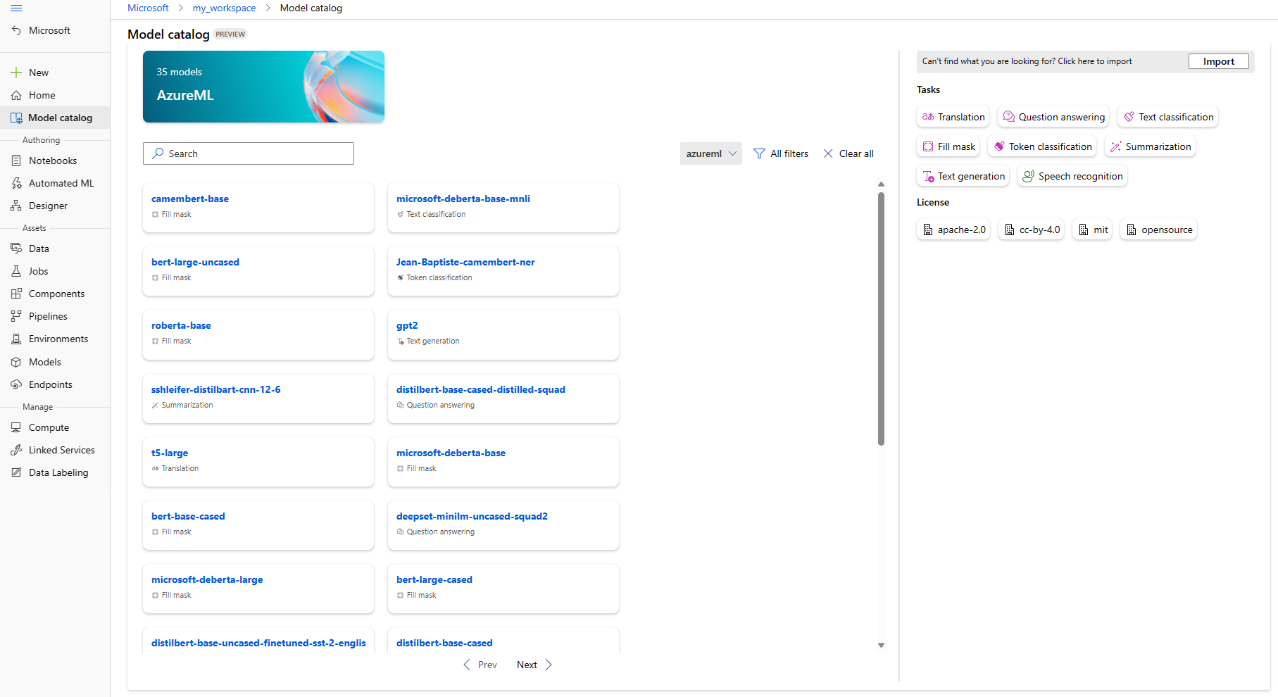
Foundation Models With Azure ML
'Model catalog' (preview) provides a catalog view of all models that you have access to via system registries. You can view the complete list of supported open-source foundation models in the Model catalog, under the azureml registry.

Slide 20
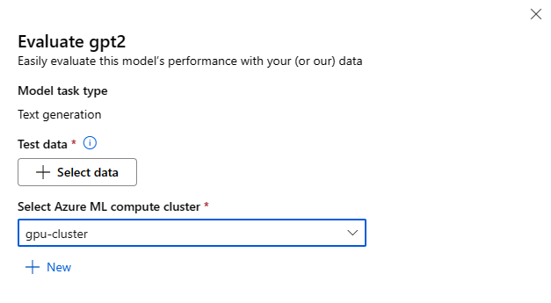
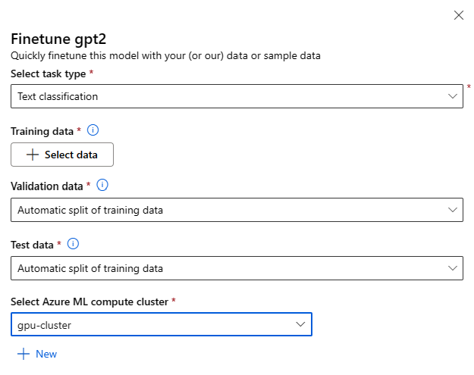
Evaluate and Finetune Foundation Models
Test Data
Compute
Advanced Evaluation Parameters
Finetuning task type

Slide 21
Lab Session

Slide 22
Session Summary
Azure ML and Azure Container for PyTorch
Training
Evaluate
Infer
Use Curated Environment
Create Custom Environment using ACPT
Easily use Deepspeed, Nebula Checkpointing and Onnxruntime accelarators for improving the efficiency for memory and compute
Register Model
Prebuilt fine tuning model evaluation
Register ONNX model for interoperability
Create online endpoint
Deploy Scoring File
Invoke the endpoint to score

Slide 23
ACPT resources
Azure Container for PyTorch – Azure Machine Learning
Azure Container for PyTorch is now generally available in Azure Machine Learning
How to create Azure Container for PyTorch custom curated environment
https://aka.ms/azureml-largescale).
https://github.com/microsoft/onnxruntime-training-examples
Notes:
General Availability Announcement: https://techcommunity.microsoft.com/t5/ai-machine-learning-blog/azure-container-for-pytorch-is-now-generally-available-in-azure/ba-p/3774616
Latest images and packages for Framework: https://learn.microsoft.com/en-us/azure/machine-learning/resource-azure-container-for-pytorch?view=azureml-api-2
How to Create the Custom Curated Environment: https://learn.microsoft.com/en-us/azure/machine-learning/how-to-azure-container-for-pytorch-environment?view=azureml-api-2

Slide 24
ACPT resources
Faster training and inference using the Azure Container for PyTorch in Azure ML
Training and deploying with PyTorch model in the cloud with Azure ML
Distributed training with PyTorch and Azure ML
Training your PyTorch model using components and pipelines in Azure ML
Notes:
General Availability Announcement: https://techcommunity.microsoft.com/t5/ai-machine-learning-blog/azure-container-for-pytorch-is-now-generally-available-in-azure/ba-p/3774616
Latest images and packages for Framework: https://learn.microsoft.com/en-us/azure/machine-learning/resource-azure-container-for-pytorch?view=azureml-api-2
How to Create the Custom Curated Environment: https://learn.microsoft.com/en-us/azure/machine-learning/how-to-azure-container-for-pytorch-environment?view=azureml-api-2

Slide 25
Thank you!

